Slide 1
.
Santiago Cuenca Perea
8B

Slide 2
How is it?
My project is a sculpure based on machism.
It will be a shadow of a woman made by cotidian objects that represent woman in a wrong way.
The mesage is to transmit an other image of the woman as it is seen every day

Slide 3
Materials and process
Sculpture: Cotidian woman objects, Light,shadow, golf voluntier, golf club
Painting: Different color paint, shadow
The sculpture will represent the machism but then I will trace a line in the shadow and paint a heroin killing the men.
The golf club in the shadow will be paint as the sword.

Slide 4
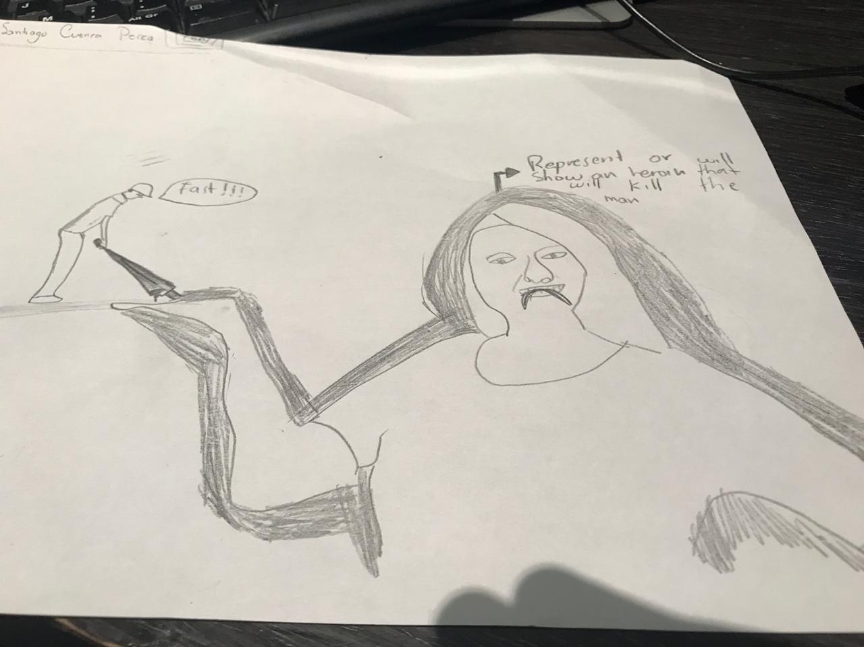
Sketch

Slide 5
Strategie
In one of the first classes we make an exercise of trasing the body of ower partner through the window and the result was very interesting so I can use this strategie to trace the line in the shadow
The art piece will be the transformation of the shadow starting with a machistic critique and then showing the woman as an important moral stereotype.

Slide 6
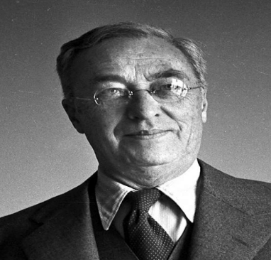
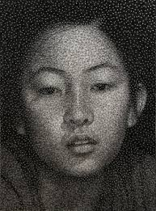
References
Vasili Kandinski was a Russian painter, forerunner of abstract art in painting and art theorist. Lyric abstraction and expressionism begin with him, born in Moscow, Kandinski spent his childhood in Odessa, where he graduated from the Grekov Odessa School of Art.
Kumi Yamashita is a Japanese artist based in New York City. He was born in 1968 in Takasaki, Japan, and then moved to the United States in high school as part of an exchange student program and has since remained in New York City.

Slide 7
End
I Hope you buy it!!!!!

